Slide 1
Applied Cryptography (21AIE431)
Encrypted Image Transmission
Group - 3 Batch - B
Nallamilli Sai Satwik Reddy - CB.EN.U4AIE21139
Vali Poorna Sasidhar Reddy - CB.EN.U4AIE21172
Venna Venkata Alluri Rohith - CB.EN.U4AIE21174
Yeturu Shashank Reddy - CB.EN.U4AIE21179

Slide 2
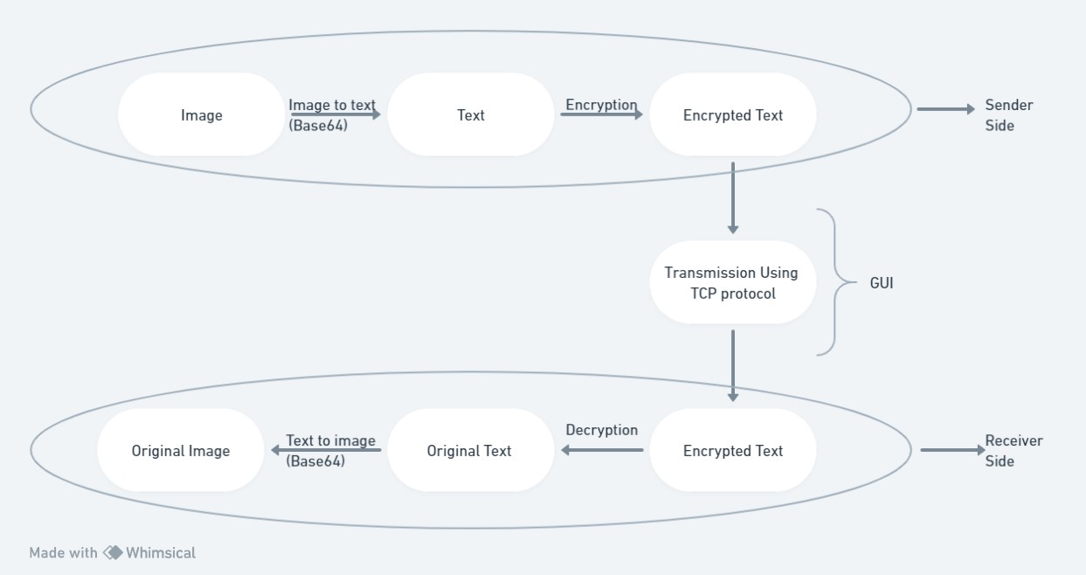
Proposed Pipeline:

Slide 3
Encoding and Decoding :
Base64 encoding/decoding is the process of converting data from its original format (e.g., binary image data) to Base64 and back. Base64 is a popular binary-to-text encoding scheme that converts binary data into a string of printable ASCII characters. It is not encryption in the traditional sense because no secret keys or algorithms are used to secure the data. It is, instead, a reversible transformation used for a variety of purposes, including encoding binary data into a text format that can be safely transmitted.
Base64 Encoding:
1.The binary data (e.g., image data) is divided into 6-bit chunks.
2.Each 6-bit chunk is represented as a single character from the Base64 character set.
3.These characters are concatenated together to form a Base64-encoded string.
Base64 Decoding:
1.The Base64-encoded string is divided into 4-character chunks.
2.Each character in the chunk is mapped back to its 6-bit binary representation.
3.These binary representations are combined to reconstruct the original binary data.

Slide 4
Transmission:
Sending a file via TCP (Transmission Control Protocol) entails first establishing a network connection between a sender (client) and a receiver (server), and then sending the file in smaller chunks or packets.
1.First, you must configure a server to accept incoming connections.
2.The server will open a socket, assign it an address and port, and then listen for incoming connections.
3. The client, on the other hand, creates a socket and connects to the server's address and port.
4. On the server side, you'll read the file in chunks and send them over the network.
5. On the client side, you'll receive the file data in chunks and write them to a new file.
6. After the file transfer is complete, close both the client and server sockets.
Process:
The Base 64 encoded file will be encrypted and safely transmitted to another system via TCP connection. When the encrypted file arrives at the receiver's end, it is decrypted and decoded back into an image.

Slide 5
Work done till now:
Encoding and Decoding Image to Text and Text to Image.
Establishing TCP connection.
Transmission of image.
Need to DO :
Image Encryption.
Developments in the encryption technique for enhanced and more secure transmission of the image data.

Slide 6
THANK YOU

